Slide 1
TASK MANAGEMENT SYSTEM
To implement the task management system with features like adding tasks, marking as completed with tick button, showing pending percentage and filtering by using html, css and js coding

Slide 2
introduction
In this project, to build a simple Task Management System that allows users to:
Add tasks
Mark tasks as completed using a tick button
See the percentage of pending tasks
Filter tasks by their status (Completed / Pending)
By using
HTML for the structure of the application
CSS for the styling
JavaScript for functionality (task logic)

Slide 3
TASK MANAGEMENT SYSTEM
Task management is the process of effectively and efficiently tracking, managing, and executing the life cycle of a task or many tasks within a project, from inception to execution. The purpose of task management is to improve the decision-making, communication, efficiency, and effectiveness of a task or project.
Task management helps teams communicate the status of various tasks and duties for a project to make sure it is progressing smoothly and in a timely manner. Being able to see what other team members are working on and what tasks have been completed helps teams stay organized and keep the momentum high.

Slide 4
How the Application Works
Adding a Task:
The user enters a task name and clicks the "Add Task" button.
A new task is added to the list and displayed on the screen.
Marking a Task as Completed:
Users can click the tick button (✔) to mark a task as completed.
Completed tasks have a line-through style and are colored differently.
Pending Task Percentage:
The pending percentage is automatically calculated based on the number of tasks marked as completed.
This is displayed at the bottom of the task list.
Filtering Tasks:
Users can filter tasks by status:
All: Shows all tasks.
Pending: Shows only tasks that are not completed.
Completed: Shows only completed tasks.

Slide 5
Features Overview
Task Management: Adding, completing, and filtering tasks.
Dynamic UI: The UI updates as the user interacts with tasks.
Pending Percentage: Real-time calculation and display of pending tasks.
Responsive Design: This can be extended to mobile or larger screens with some CSS tweaks

Slide 6
FEATURES IMPROVEMENTS
Task Deletion: Allow users to delete tasks.
Task Editing: Let users modify existing tasks.
Save Tasks: Use Local Storage or a backend database to persist tasks across page reloads

Slide 7
HTML Structure
<!DOCTYPE html>
<html lang="en">
<head>
<meta charset="UTF-8">
<meta name="viewport" content="width=device-width, initial-scale=1.0">
<title>Task Management System</title>
<link rel="stylesheet" href="styles.css">
</head>
<body>
<div class="container">
<h1>Task Management</h1>
<input type="text" id="task-input" placeholder="Add a new task">
<button id="add-task-btn">Add Task</button>
<select id="filter" onchange="filterTasks()">
<option </html>

Slide 8
CSS
body {
font-family: Arial, sans-serif;
background-color: #f4f7f6;
margin: 0;
padding: 0;
}
.container {
width: 400px;
margin: 50px auto;
background: #fff;
padding: 20px;
box-shadow: 0 4px 8px rgba(0, 0, 0, 0.1);
border-radius: 8px;
}
h1 {
text-align: center;
color: #333;
}
input[type="text"] {

Slide 9
width: 70%;
padding: 10px;
margin-bottom: 10px;
border: 1px solid #ddd;
border-radius: 4px;
}
button {
padding: 10px 20px;
background-color: #4CAF50;
color: white;
border: none;
border-radius: 4px;
cursor: pointer;
}
button:hover {
background-color: #45a049;
}
select {
margin-bottom: 20px;
padding: 5px;

Slide 10
border-radius: 4px;
}
#task-list {
margin-bottom: 20px;
}
.task {
display: flex;
justify-content: space-between;
align-items: center;
background: #f9f9f9;
margin-bottom: 5px;
padding: 10px;
border-radius: 4px;
border: 1px solid #ddd;
}
.task.completed {
text-decoration: line-through;
background-color: #e0ffe0;
}
#pending-percentage {
text-align: center;
font-size: 16px;
font-weight: bold;
}

Slide 11
javascript
Copy code
let tasks = [];
document.getElementById('add-task-btn').addEventListener('click', addTask);
function addTask() {
const taskInput = document.getElementById('task-input');
const taskText = taskInput.value.trim();
if (taskText !== "") {
const newTask = {
id: Date.now(),
text: taskText,
completed: false
};
tasks.push(newTask);
taskInput.value = ''; // clear the input
renderTasks();
updatePendingPercentage();
}
}
function renderTasks() {
const taskList = document.getElementById('task-list');
taskList.innerHTML = ''; // Clear the task list first
tasks.forEach(task => {
const taskElement = document.createElement('div');
taskElement.classList.add('task');
if (task.completed) taskElement.classList.add('completed');

Slide 12
taskElement.innerHTML = `
<span>${task.text}</span>
<button onclick="toggleCompletion(${task.id})">✔</button>
`;
taskList.appendChild(taskElement);
});
}
function toggleCompletion(taskId) {
const task = tasks.find(t => t.id === taskId);
task.completed = !task.completed;
renderTasks();
updatePendingPercentage();
}
function updatePendingPercentage() {
const totalTasks = tasks.length;
const completedTasks = tasks.filter(t => t.completed).length;
const pendingPercentage = totalTasks === 0 ? 0 : Math.round(((totalTasks - completedTasks) / totalTasks) * 100);
document.getElementById('pending-percentage').innerText = `Pending: ${pendingPercentage}%`;
}

Slide 13
function filterTasks() {
const filter = document.getElementById('filter').value;
let filteredTasks = tasks;
if (filter === 'pending') {
filteredTasks = tasks.filter(task => !task.completed);
} else if (filter === 'completed') {
filteredTasks = tasks.filter(task => task.completed);
}
renderFilteredTasks(filteredTasks);
}
function renderFilteredTasks(filteredTasks) {
const taskList = document.getElementById('task-list');
taskList.innerHTML = '';
filteredTasks.forEach(task => {
const taskElement = document.createElement('div');
taskElement.classList.add('task');
if (task.completed) taskElement.classList.add('completed');
taskElement.innerHTML = `
<span>${task.text}</span>
<button onclick="toggleCompletion(${task.id})">✔</button>
`;
taskList.appendChild(taskElement);
});
}

Slide 14
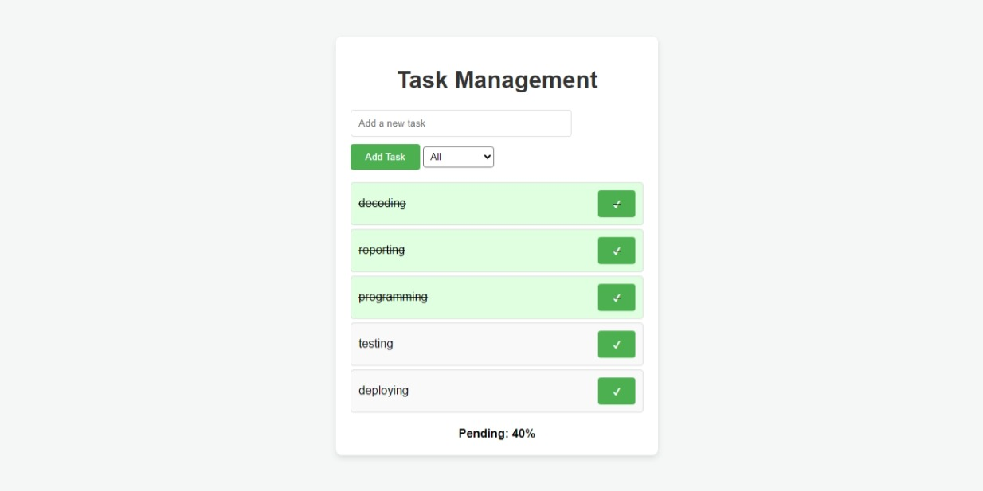
OUTPUT

Slide 15
Conclusion
We’ve successfully built a simple Task Management System using HTML, CSS, and JavaScript. The system allows us to:
Add tasks
Mark them as completed
View the pending percentage
Filter tasks based on status
IT CAN BE EVEN expanded tO further UPDATION with additional features like task priorities, deadlines, or user authentication.

Slide 16
THANK YOU

